Slide 1
Confronting the Missing Human Attack Surface
How To Uncover and Defend Against
Hidden Threats to Your Business
Presented by:
Steve Thomas, Founder and CEO, HackNotice

Slide 2


Speaker Bio
Steve Thomas & HackNotice
About HackNotice:
Human-Centric Threat Intelligence Platform: Uncover Your Human Attack Surface Area
Series A Company based in Austin, TX
Our customers say HackNotice is the ‘Gold Standard’ in breach data, that identifies, analyzes, and alerts on threats to human attack surfaces, offering real-time protection against digital threats.
Trusted by:
Fortune 5
Tier 1 U.S. Banks
Industry Leading Third Party Risk Mgmt Providers
Federal Institutions
Founder and CEO
Threat intelligence engineer turned serial entrepreneur for over +15 years, Steve built, bootstrapped, and sold the world’s first threat intelligence startup in 2013.
2
First Party Monitoring
Third Party Monitoring
End User Monitoring
Research

Slide 3
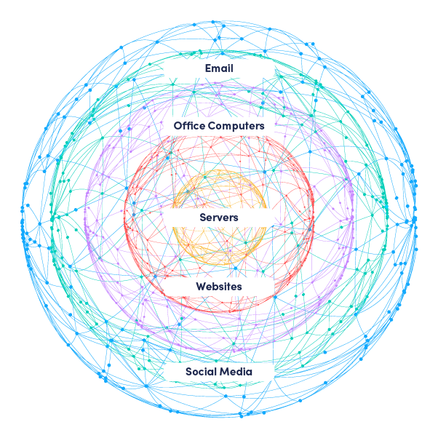
Traditional
Traditional Attack Surface
3

Slide 4
Traditional
Traditional attack surface is incomplete
98%
of cyberattacks involve social engineering.¹
90%
of the total attack surface of high-value targets is unaddressed.⁶
50% +
of organizations and over 70% of employees use personal devices at work.²
95%
of enterprise network attacks
that succeed rely on spear phishing to gain entry.⁵
50%
of large enterprise CISOs will have adopted human-centric security by 2027.⁴
By 2025,
AI-enabled fraud will fundamentally change enterprise attack surfaces.⁴
69%
of employees
have bypassed their organization’s cybersecurity guidance in the past 12 months.³
*Recent major data breaches using employee personal assets: Cisco, Okta
4

Slide 5
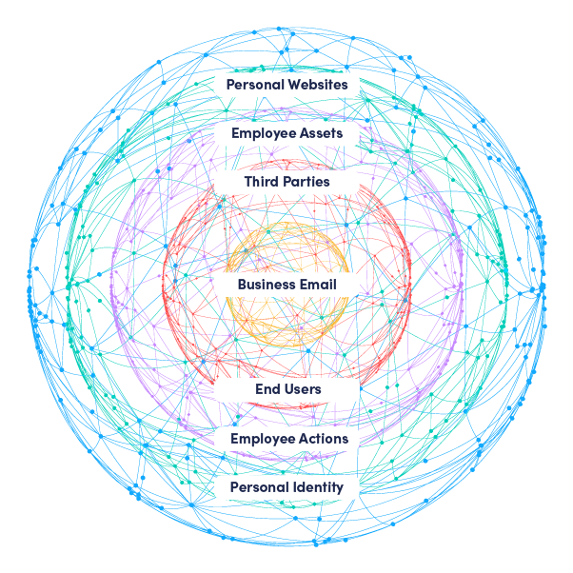
Human
Human Attack Surface
5

Slide 6
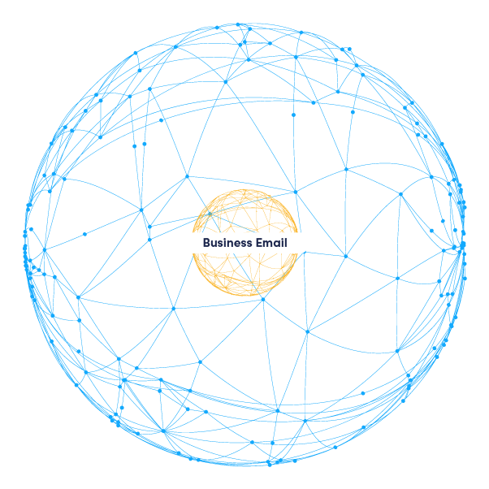
Human
Business Email
6

Slide 7
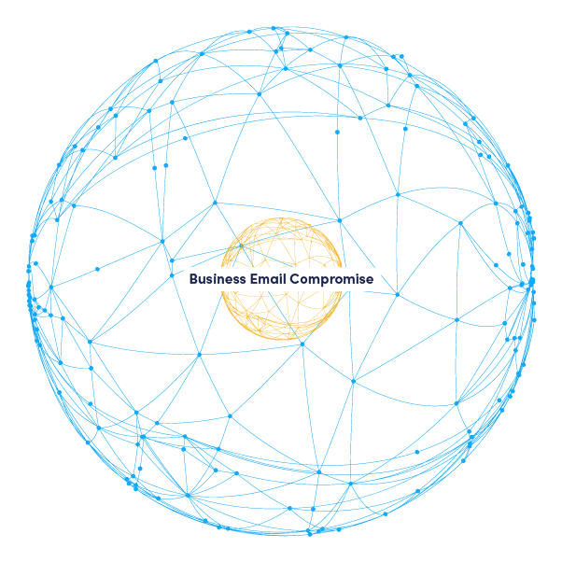
Human
Business Email Compromise
7

Slide 8
Human
Business Email Compromise
81%
surge in BEC attacks was reported in 2022 and 98% of employees failed to report threats.⁷
21,832
companies sent BEC complaints to the FBI In 2022, with estimated losses totaling more than $2.7 billion.⁸
78%
of phishing attacks were read and replied to by entry-level sales associates. Employees open 28% of attacks and reply to 15% of them.⁷
35 million
business email compromise attempts, with an average of 156,000 attempts daily, were detected and investigated by Microsoft Threat Intelligence between April 2022 and April 2023.⁹
8

Slide 9

Human
First Party Monitoring
9

Slide 10
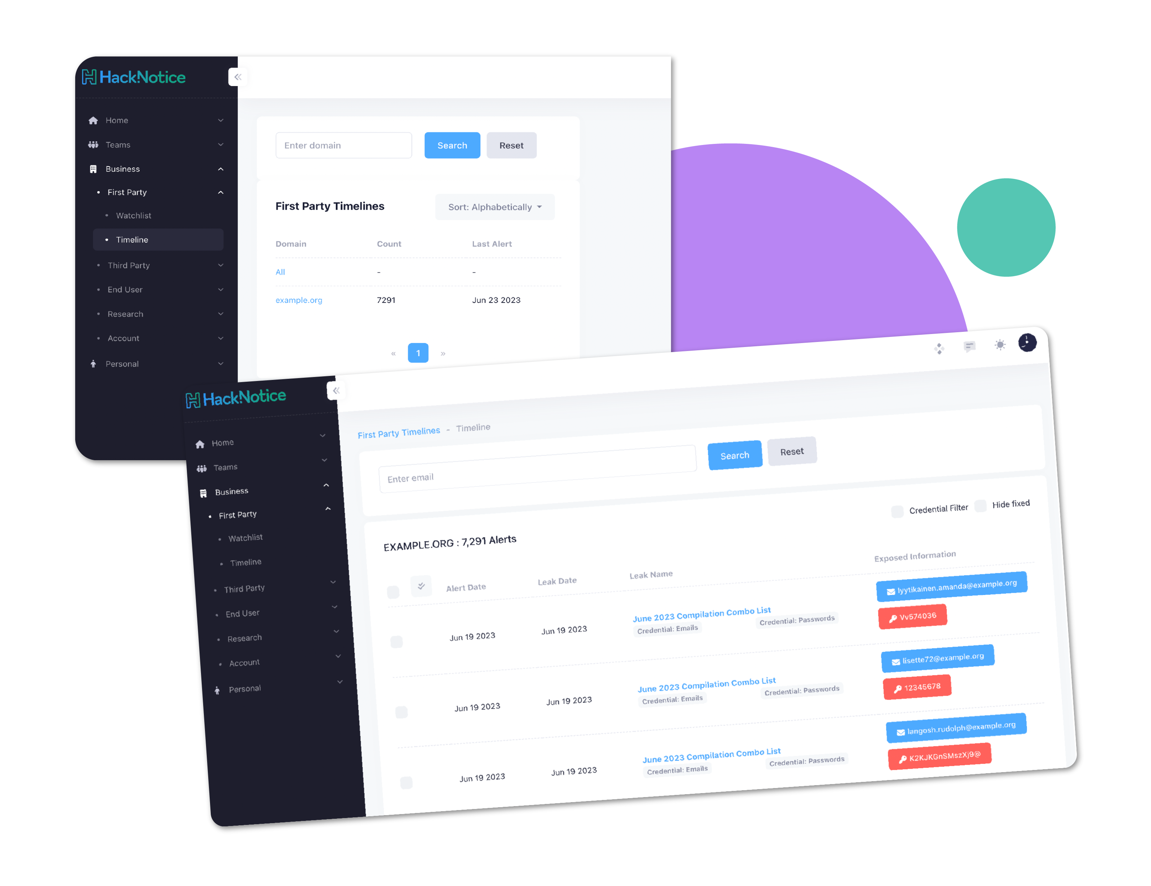
Human
First Party Monitoring Demo
Get complete visibility into your risk landscape for all employees and assets
Track risks down to specific breaches, leaks, and records that hackers are sharing
Understand the context of the intelligence, including all the metadata surrounding your risk
Easily integrate the intelligence into your existing infrastructure
10

Slide 11
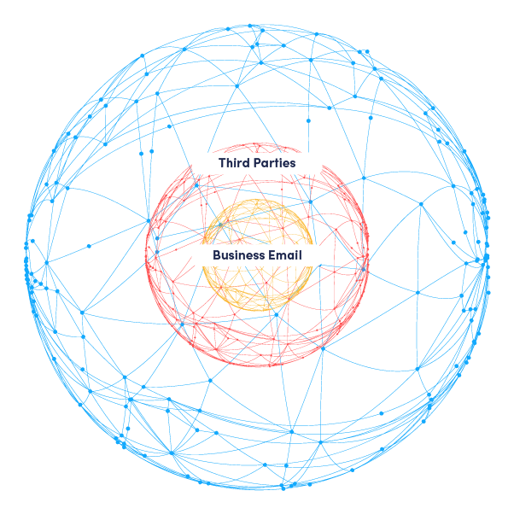
Human
Third Parties
11

Slide 12
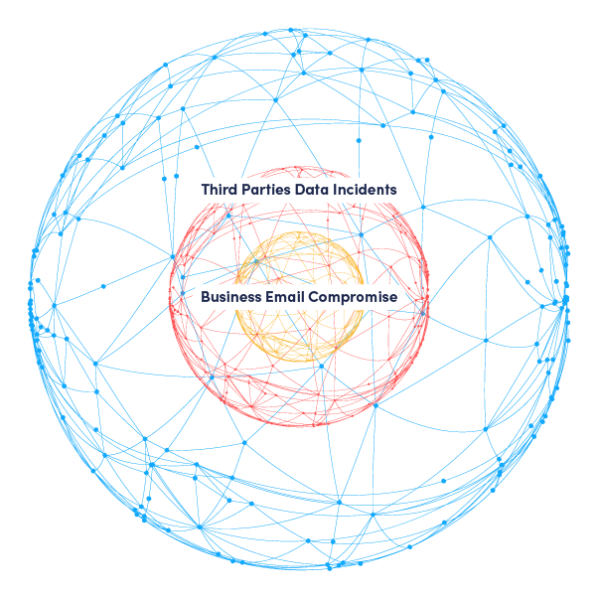
Human
Third Party Risk
12

Slide 13
Human
Third Party Risk
75
days pass on average
between an attack and the disclosure date.¹⁰
54%
of businesses
do not vet third-party vendors properly. Only 36% of companies have automated this process.¹¹
80%
of surveyed organizations
last year experienced at least one data breach caused by a third party.¹⁰
2022
saw a big uptick
in cyberattacks attributed to third-party affiliates and services.¹²
98%
of organizations have at least one vendor that has suffered a breach in the past two years.¹²
13

Slide 14
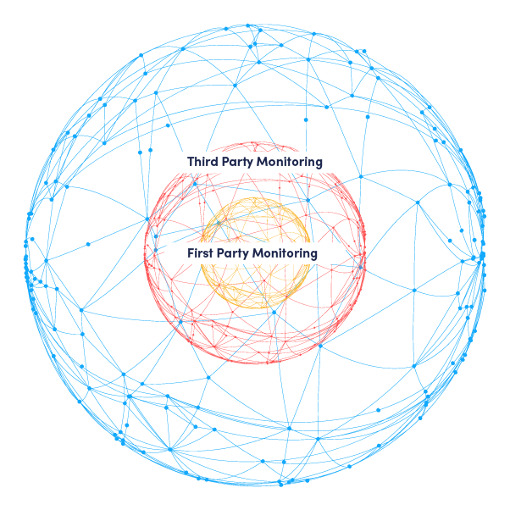
Human
Third Party Monitoring
14

Slide 15
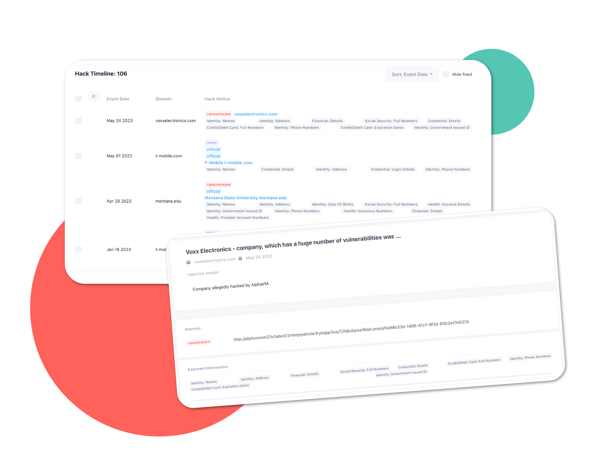
Human
Third Party Monitoring Demo
Get a full history of data breaches for each of your vendors, including what data was stolen
Review new potential vendors for risk before signing contracts
See the vendor’s level of threat intelligence exposure
Identify compliance and regulatory issues
15

Slide 16
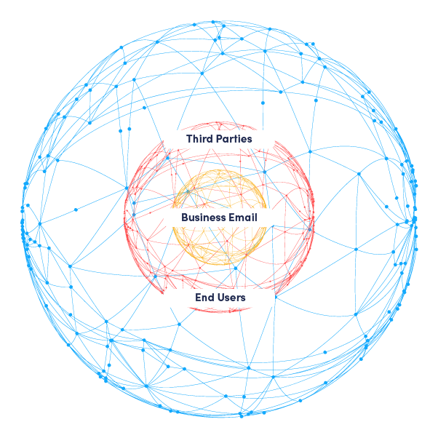
Human
End Users
16

Slide 17
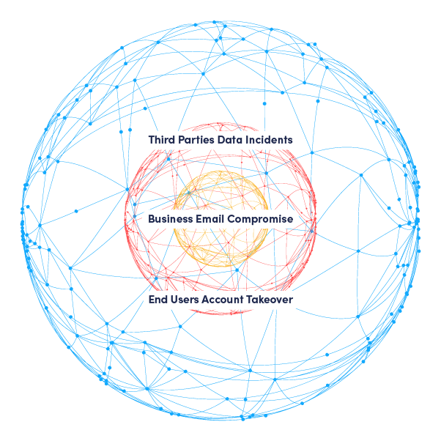
Human
End Users Account Takeover
17

Slide 18
Human
End User Account Takeover (ATO)
307%
increase in ATO attacks was recorded between 2019 and 2021.¹³
22%
of U.S.
adults have been victims of ATOs (24M households).¹⁵
$11.4B
in ATO losses were reported in 2021.¹⁴
131%
increase in ATO attacks was recorded in just the first half of 2022.⁶
1/3
of all login attempts on retail
e-commerce sites were account takeover attempts.¹⁷
18

Slide 19
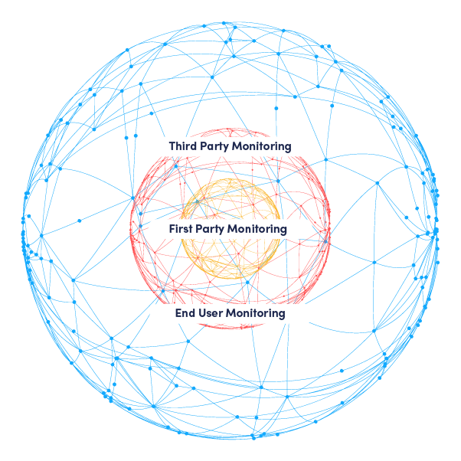
Human
End User Monitoring
19

Slide 20
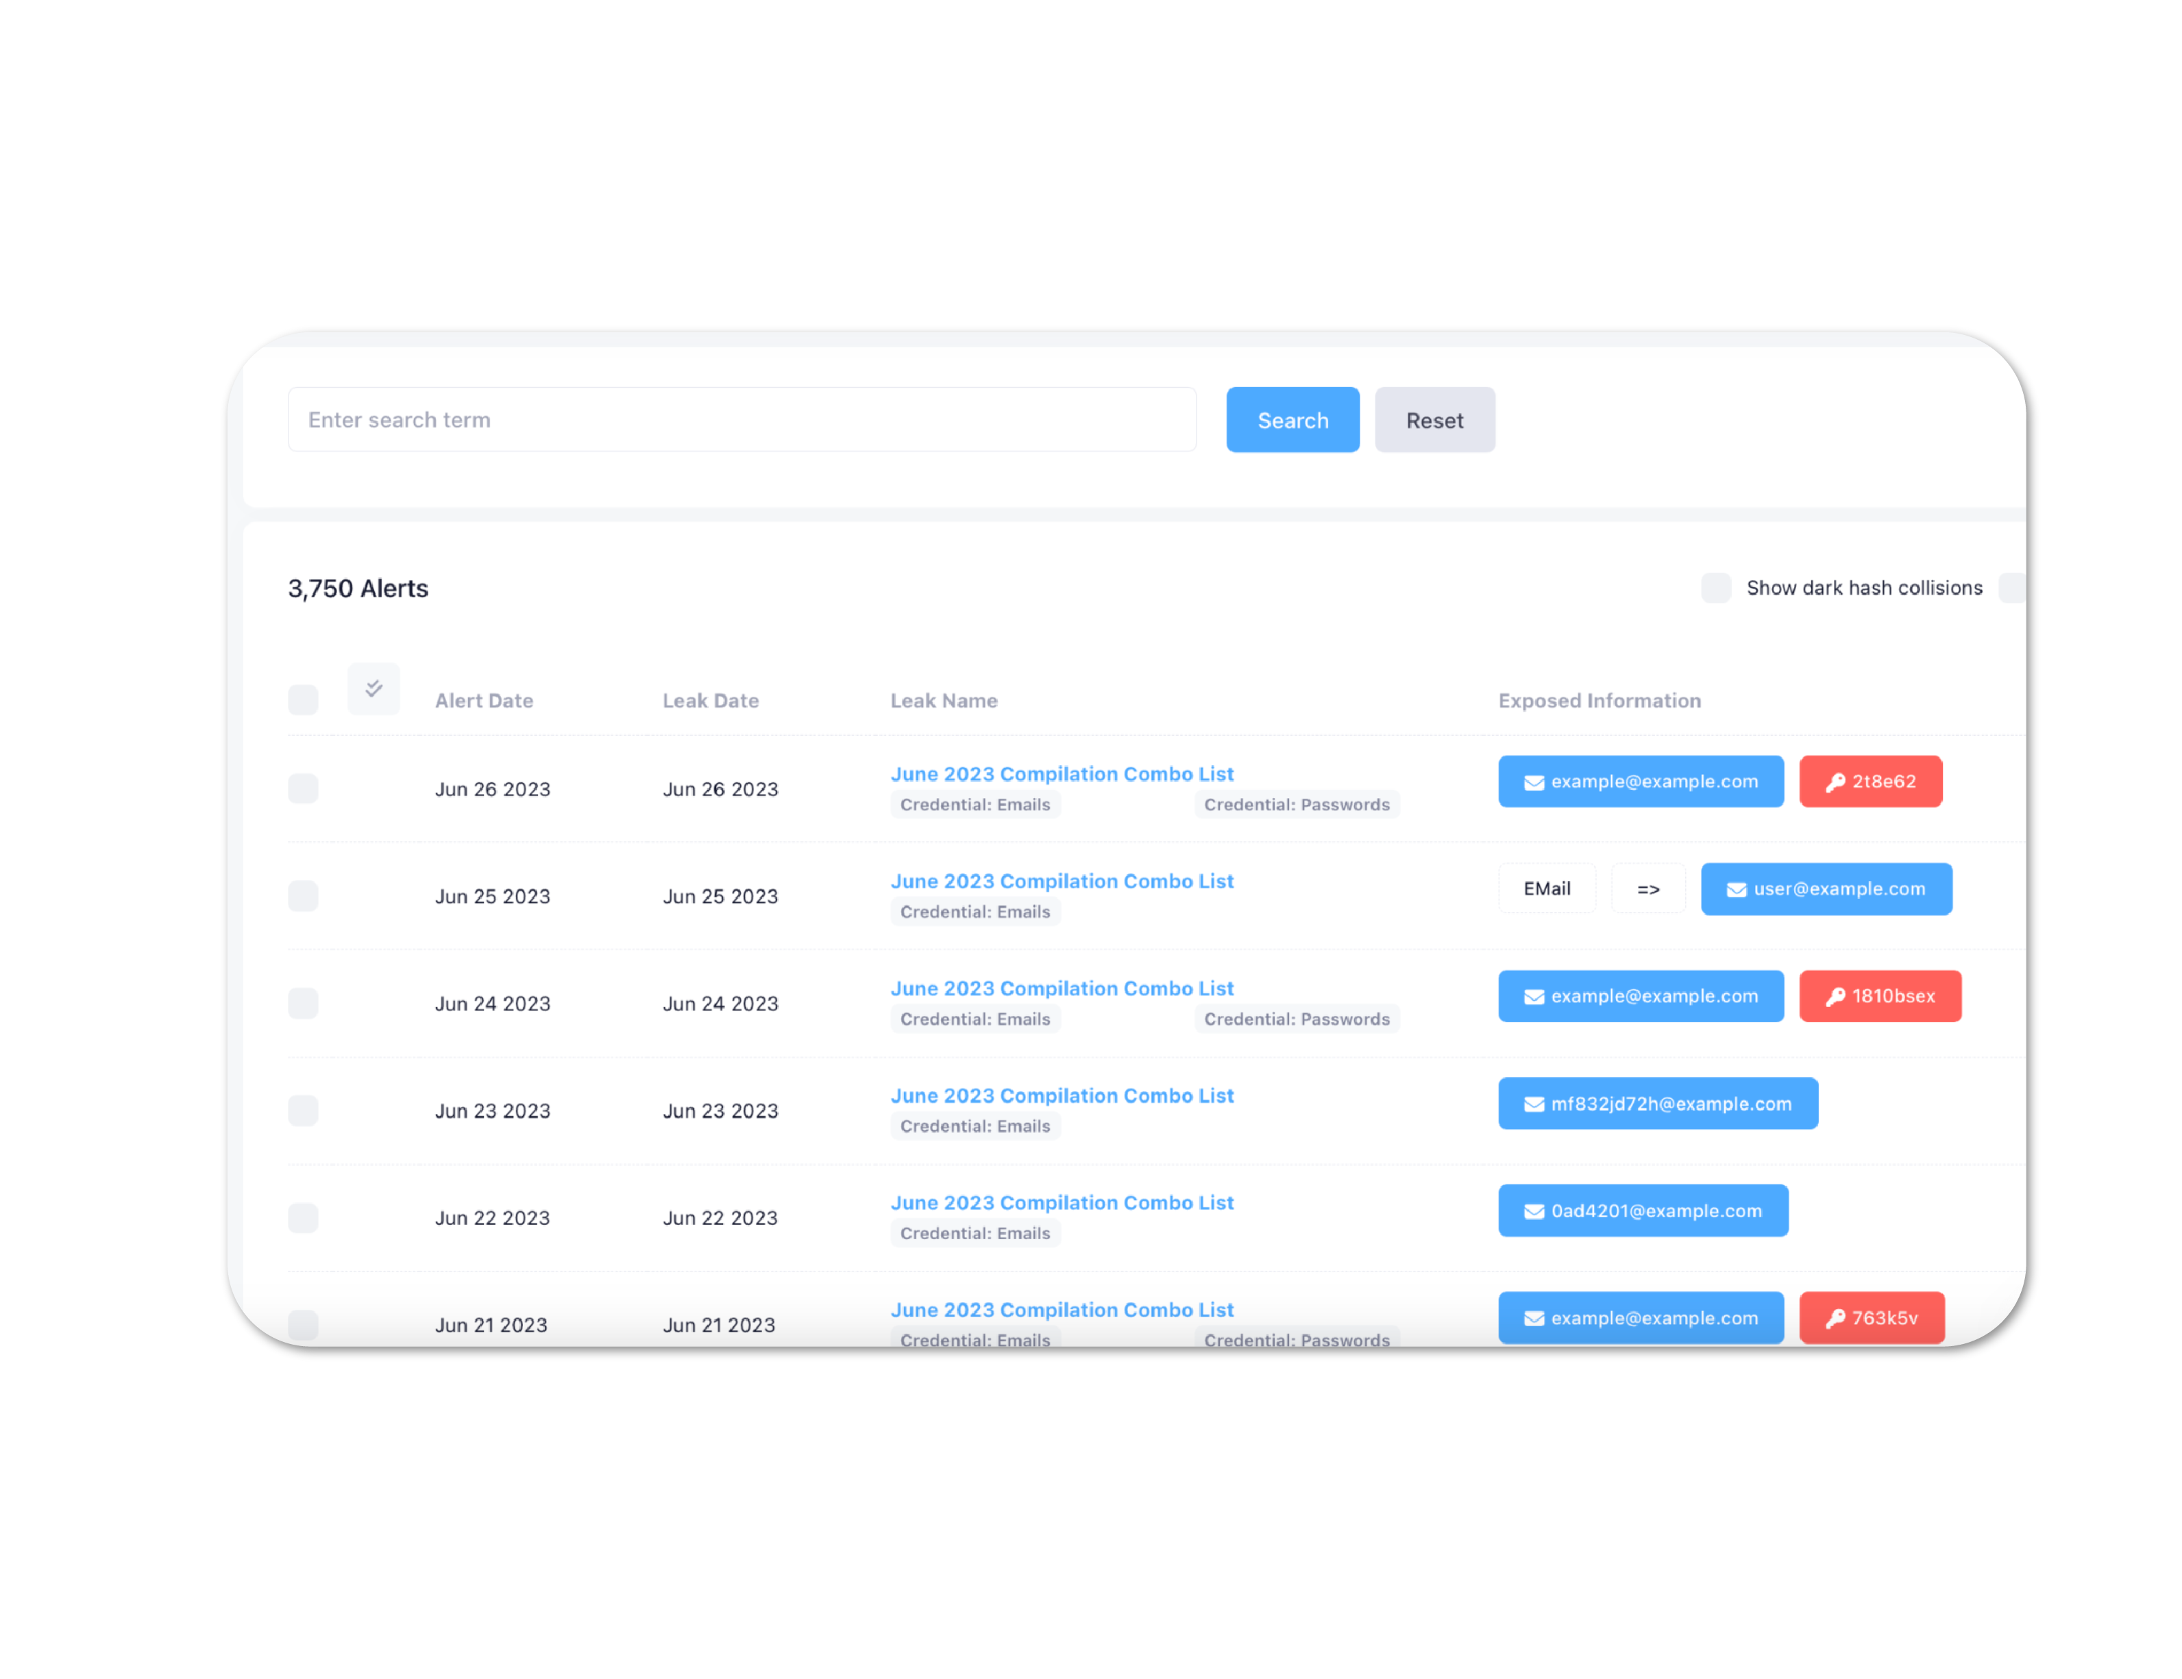
Human
End User Monitoring Demo
Instantly find your most at-risk end users
Preemptively use credential spraying endpoints to find and lock down vulnerable accounts
Build trust with your end users by warning them of their risks and making sure they know that you are taking steps to protect them
Be notified in real time as hackers find new targets for their attacks
20

Slide 21
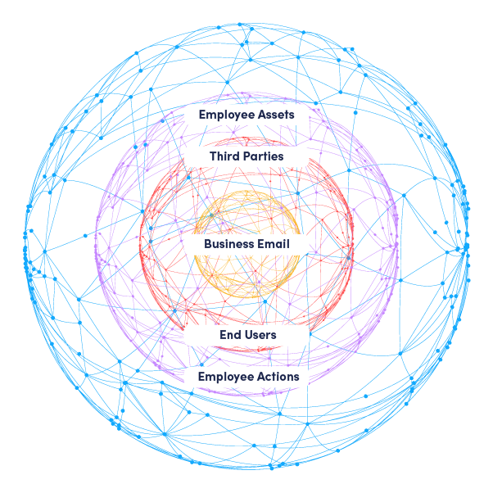
Human
Employee Actions / Assets
21

Slide 22
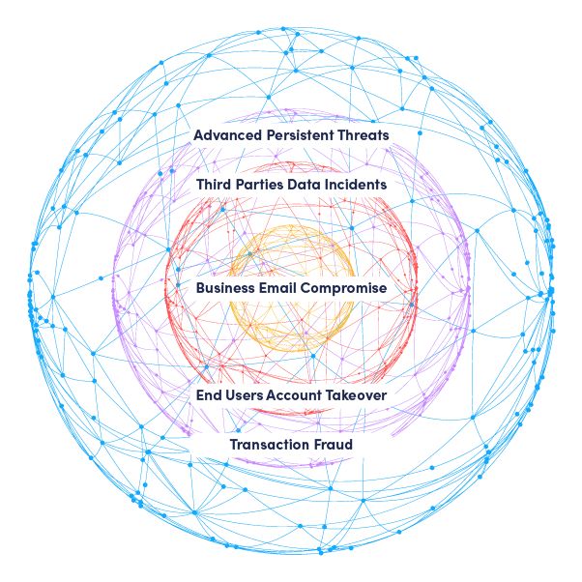
Human
APT & Fraud
22

Slide 23
Human
Advanced Persistent Threats & Fraud
34%
of companies experienced damage to their reputation as a result of an APT attack.¹
78%
of companies experience downtime as a result of an APT attack.¹
68%
of companies experienced a targeted attack on their networks and suffered data loss as a direct result of APT.¹
$4.8 million
of damages is the average cost of an APT attack.
146
days pass on average before APT attacks are detected.¹⁹
23

Slide 24
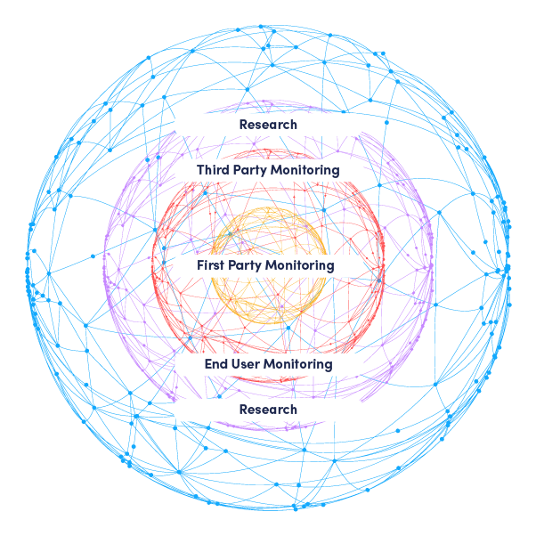
Human
Research
24

Slide 25
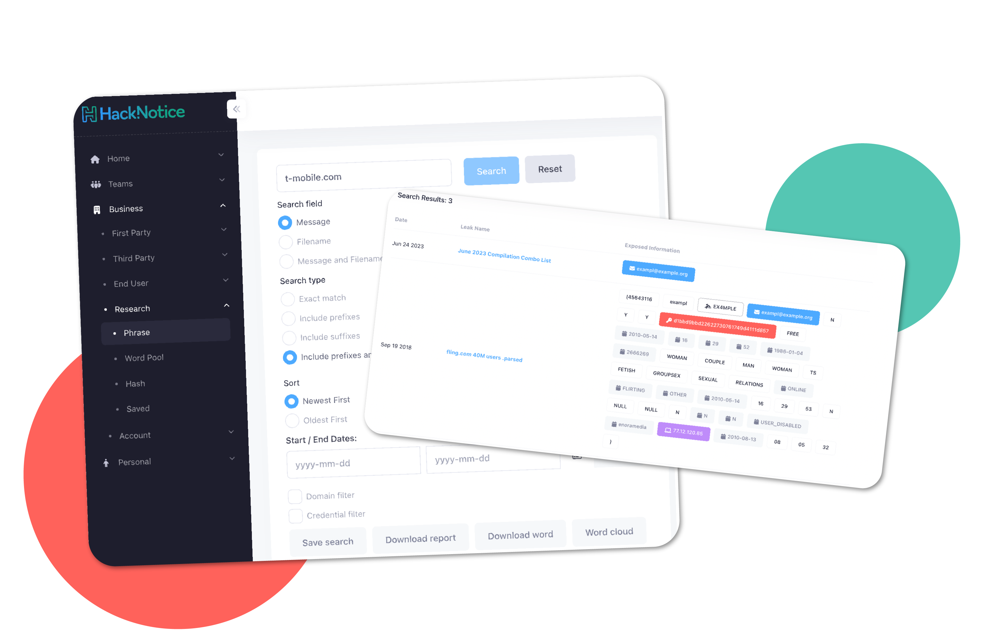
Human
Research Service Demo
Search any risk element in real time, identifying the causes of fraud and the origins of attacks
Research sensitive internal project or business partnerships, through a log-free search engine
Instantly power any platform through our real time, RESTful API
See the exact files and locations of your risk, so you know how hackers are passing your information
25

Slide 26
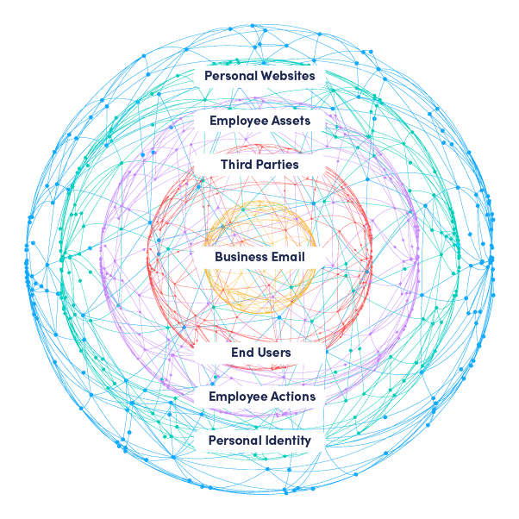
Human
Personal Websites / Identities
26

Slide 27
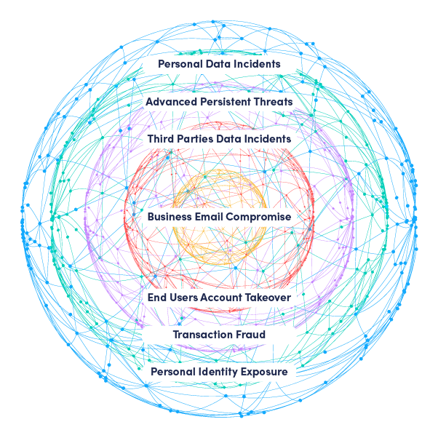
Human
Personal Breaches / Leaks
27

Slide 28
Human
Personal Breaches / Leaks
22%
of organizations say their employees’ BYOD devices have downloaded malware over the past 12 months.²⁰
>70%
of employees
use personal devices at work.²¹
22%
of organizations say their employees’ devices have connected to malicious WiFi over the past year.²⁰
36.1%
of employees
use a combination of company and personal devices.²²
41%
of organizations have control over file sharing on employee-owned devices and 37% have control over cloud-connected apps.²²
62%
of cybersecurity professionals cite data loss and leaks as their top BYOD-related concerns.¹⁹
30%
of organizations have zero visibility or control over employees’ mobile messaging.¹⁹
64%
of CISOs
believe that remote working has drastically increased their exposure to cyber threats.²³
28

Slide 29
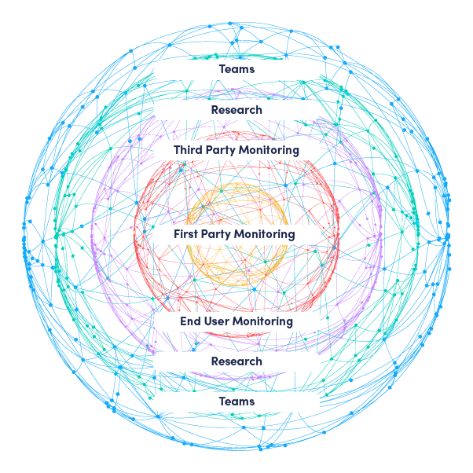
Human
HackNotice Teams
29

Slide 30
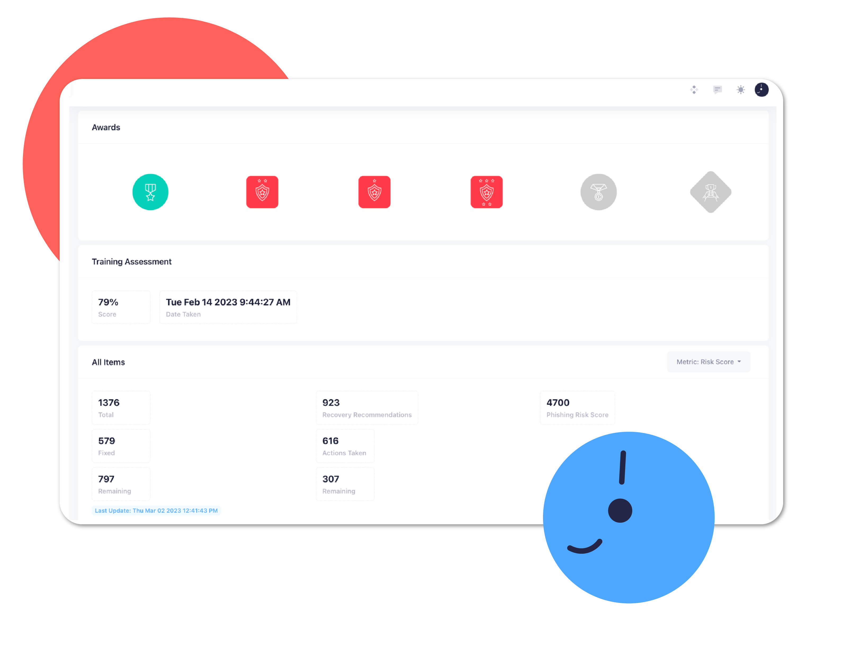
Human
HackNotice Teams Demo
Employees are alerted to exposed PII that can maliciously be used against them.
Receive metrics about which employees are at a high risk of being targeted, attacked, and breached.
Includes traditional security awareness training library and phishing simulations that check all the compliance boxes, sent to employees right when they need it.
Engages employees, providing them with personalized alerts that drive motivation.
30

Slide 31
Traditional
Traditional Attack Surface
31

Slide 32
Human
Human Attack Surface Protected
32

Slide 33
Human
Threats
33

Slide 34


Visit us at
Start-up City
Booth SC110
Contact :
833.422.5900
steve@hacknotice.com
Questions? Let’s talk!
Thank you!!!

Slide 35
References
PurpleSec. “2023 Cyber Security Statistics Trends & Data,” 2023. https://purplesec.us/resources/cyber-security-statistics/.
Perception Point. “BYOD Security: Threats, Security Measures and Best Practices,” 2023. https://perception-point.io/byod-security-threats-security-measures-and-best-practices/.
Gartner, Inc.. “Gartner Predicts Nearly Half of Cybersecurity Leaders Will Change Jobs by 2025,” July 31, 2023. https://www.gartner.com/en/newsroom/press-releases/2023-02-22-gartner-predicts-nearly-half-of-cybersecurity-leaders-will-change-jobs-by-2025.
Deepti Gopal, Leigh McMullen, Andrew Walls, Richard Addiscott, Paul Furtado, Craig Porter, Oscar Isaka, Charlie Winckless. “Predicts 2023: Cybersecurity Industry Focuses on the Human Deal,” Gartner, Inc., 25 Jan 2023.
Security Intelligence. “Improving Your Security Awareness Campaigns With Behavioral Science,” 24 June 2015 https://securityintelligence.com/improving-your-security-awareness-campaigns-examples-from-behavioral-science/.
Picnic. “Threat-Informed Defense for Human Attack Surface.” Picnic, 27 April 2023. https://getpicnic.com/2023/04/27/threat-informed-defense-for-human-attack-surface-mapping-threat-intelligence-to-target-intelligence/.
Abnormal. “Data Shows 28% of BEC Attacks Opened by Employees,” 2023. https://abnormalsecurity.com/resources/h1-2023-report-employee-open-rates.
SpyCloud, Team. “2023 Cybersecurity Industry Statistics: ATO, Ransomware, Breaches.” SpyCloud, 15 June 2023. https://spycloud.com/blog/2023-cybersecurity-industry-statistics-account-takeover-ransomware-data-breaches-bec-fraud/.
Microsoft Stories. “Microsoft Cyber Signals Report Highlights Spike in Cybercriminal Activity around Business Email Compromise - Microsoft Stories Asia.” Microsoft Stories Asia, 22 May 2023. https://news.microsoft.com/apac/2023/05/22/microsoft-cyber-signals-report-highlights-spike-in-cybercriminal-activity-around-business-email-compromise/.
Black Kite. “2022 Third-Party Breach Report,” Black Kite, 2022. https://blackkite.com/wp-content/uploads/2022/01/Third-Party-Breach-Report-2022.pdf.

Slide 36
References
11. James, Nivedita. “47 Third Party Data Breach Statistics: The Numbers You Need to Know.” Astra Security Blog, January 6, 2023. https://www.getastra.com/blog/security-audit/third-party-data-breach-statistics/.
12. Resmo. “40+ Third-Party Data Breach Statistics for 2023 | Resmo,” 2023. https://www.resmo.com/blog/third-party-data-breach-statistics. (Citing Gartner, Inc.)
13. Sift Resources. “Q3 2021 Digital Trust & Safety Index,” 2023. https://resources.sift.com/ebook/q3-2021-digital-trust-safety-index-battling-new-breed-account-takeover/.
14. Javelin. “Identity Fraud Losses Total $52 Billion in 2021, Impacting 42 Million U.S. Adults,” 29 Mar 2022. https://javelinstrategy.com/press-release/identity-fraud-losses-total-52-billion-2021-impacting-42-million-us-adults.
15. Security.org. “Account Takeover 2021 Annual Report: Prevalence, Awareness and Prevention | Security.Org,” 2021. https://www.security.org/digital-safety/account-takeover-annual-report/.
16. VentureBeat. “Report: Account Takeover Attacks Spike – Fraudsters Take Aim at Fintech and Crypto.” VentureBeat, 28 Nov 2022. https://venturebeat.com/security/report-account-takeover-attacks-spike-fraudsters-take-aim-at-fintech-and-crypto/. (Citing Sift report)
17. Lynch, B. “New Research Reveals That One Third of All Log-in Attempts on eCommerce Sites Are Malicious.” Imperva, 14 Dec 2021. https://www.imperva.com/blog/new-research-reveals-that-one-third-of-all-log-in-attempts-on-ecommerce-sites-are-malicious/.
18. Chahal, Khushboo. “Behind the Screens: Exposing the Diverse Range of Daily Cyber Attacks,” Security Boulevard, 20 June 2023. https://securityboulevard.com/2023/06/behind-the-screens-exposing-the-diverse-range-of-daily-cyber-attacks/. (Citing Accenture)
19. Verizon. “2021 Data Breach Investigations Report,” 2021. https://www.verizon.com/business/resources/reports/dbir/2021/masters guide/summary-of-findings/.

Slide 37
References
20. Cybersecurity Insiders. “2021 BYOD Security Report [Bitglass] - Cybersecurity Insiders,” 02 June 2021. https://www.cybersecurity-insiders.com/portfolio/2021-byod-security-report-bitglass/.
21. Perception Point. “BYOD Security: Threats, Security Measures and Best Practices,” 2023. https://perception-point.io/byod-security-threats-security-measures-and-best-practices/.
22. Howarth, J. “24+ Fascinating BYOD Statistics (2023),” 14 Sep 2022. https://explodingtopics.com/blog/byod-stats.
23. Informer. “The Human Attack Surface - A Serious Threat To Cyber Security,” 8 Feb 2021. https://informer.io/resources/the-human-attack-surface-a-serious-threat-to-cyber-security.

